Slide 1
🤖 ROBOTICS COURSE — SESSION 10
Welcome to Robotics!
Build Your Robot Track! 🤖🛣️

Slide 2
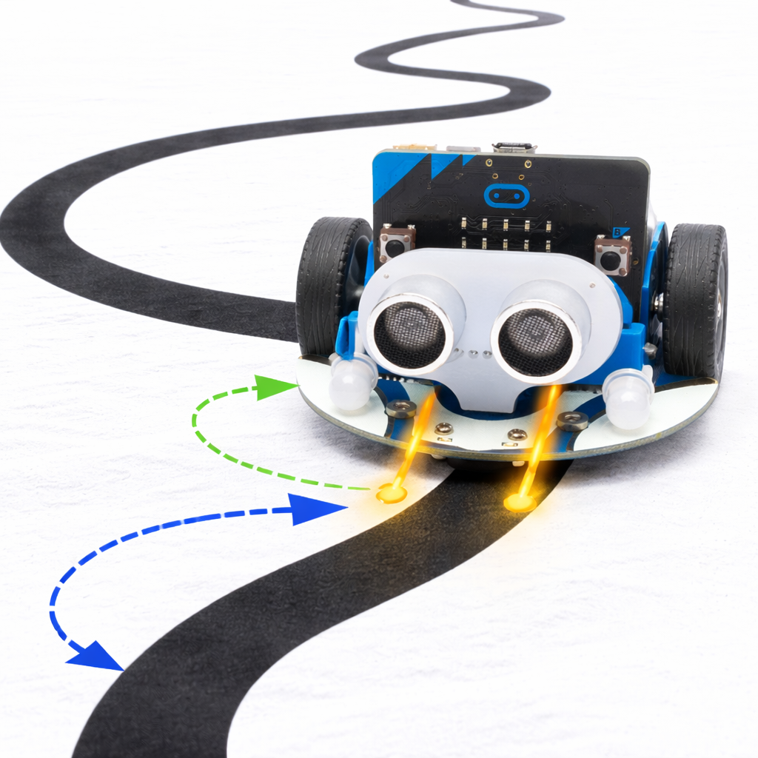
Today’s Objectives
1️⃣ Build your own track
Use the track sheets
Cut with scissors ✂️
Connect pieces using tape
Create a long and interesting path

Slide 3
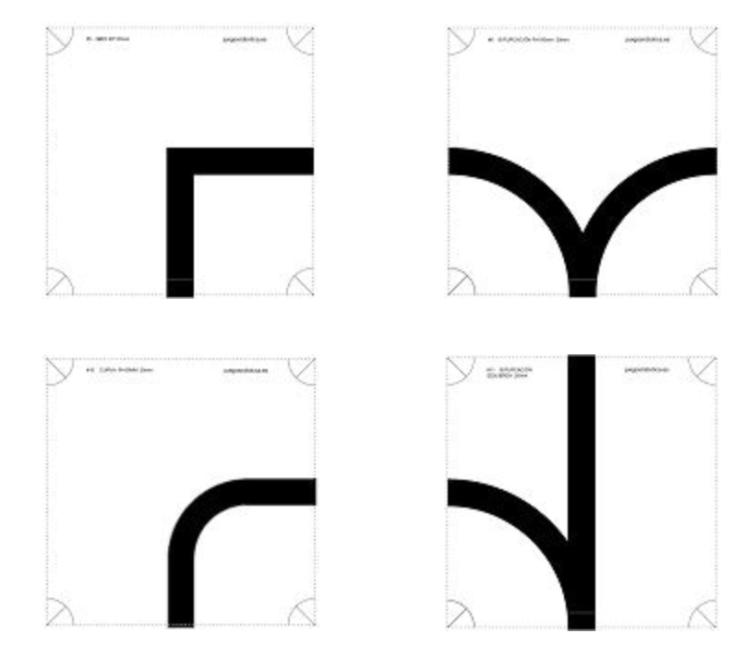
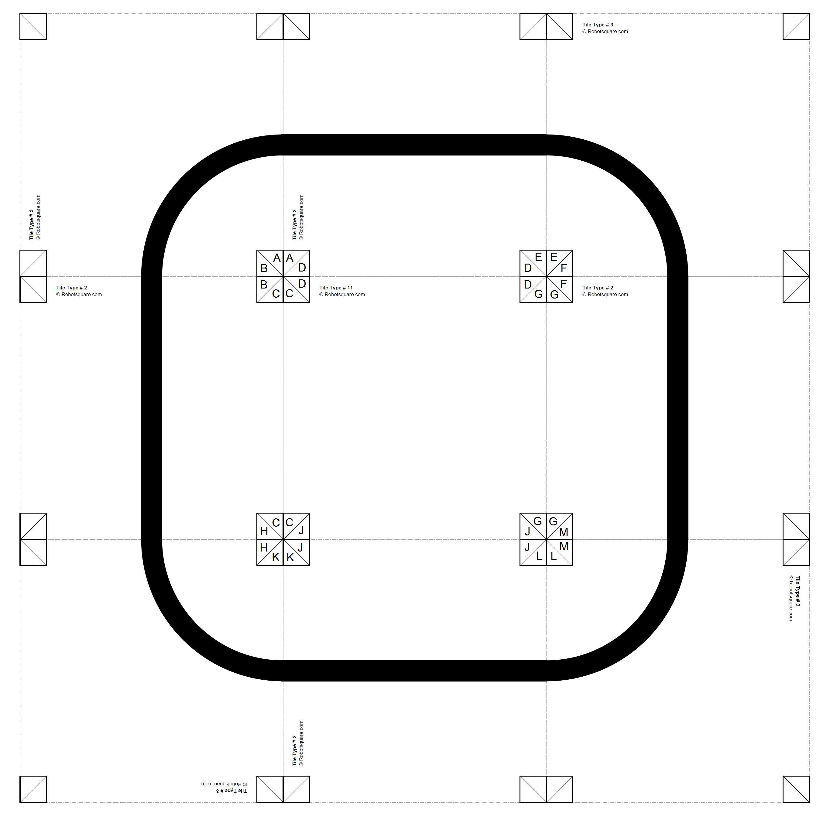
2️⃣ Design your challenge track
You can include:
turns
curves
intersections
loops
S-shapes
Be creative! 🎨 Make a track that challenges your robot.

Slide 4
3️⃣ Improve your robot code
Test different versions of your program
Adjust speed
Adjust turn strength
Improve how your robot follows the line
Use the version that works best for your robot ✅
Engineering means:
Test → Observe → Improve → Repeat 🔁
Try again until your robot drives smoothly!

Slide 5
